Slide 1

GATE C MPASS
A smart web-based platform for GATE CSIT aspirants
Features mock tests, trend analysis, timers & analytics.

Slide 2

Problem Statement
GATE aspirants lack personalized, trend‑focused preparation tools.
Manual selection of concepts and questions is time-consuming.
No integrated system for mock test generation with real exam-like timers.
Limited analytics for identifying weak concepts & improvement areas.

Slide 3
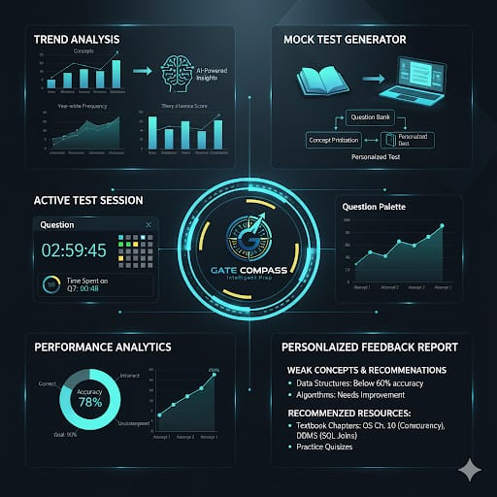
Product/ Solution - Innovation
AI-driven trend analysis of previous years’ GATE CSIT questions.
Smart mock test generator based on concept importance.
Integrated 3-hour timer & per-question time tracking.
Concept-wise performance analytics & personalized feedback.

Slide 4
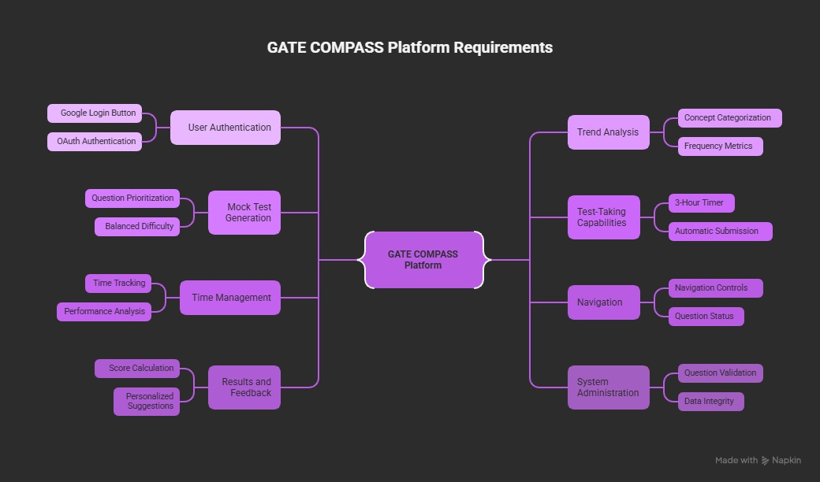

Slide 5
Market Landscape – Potential & Competitors
Large number of GATE CSIT aspirants every year (~2L+).
High demand for structured and analytics-driven preparation tools.
Competitors: MadeEasy, Testbook, Unacademy (but no trend-based generator).
Uniqueness: Automated trend-based personalized mock tests.

Slide 6
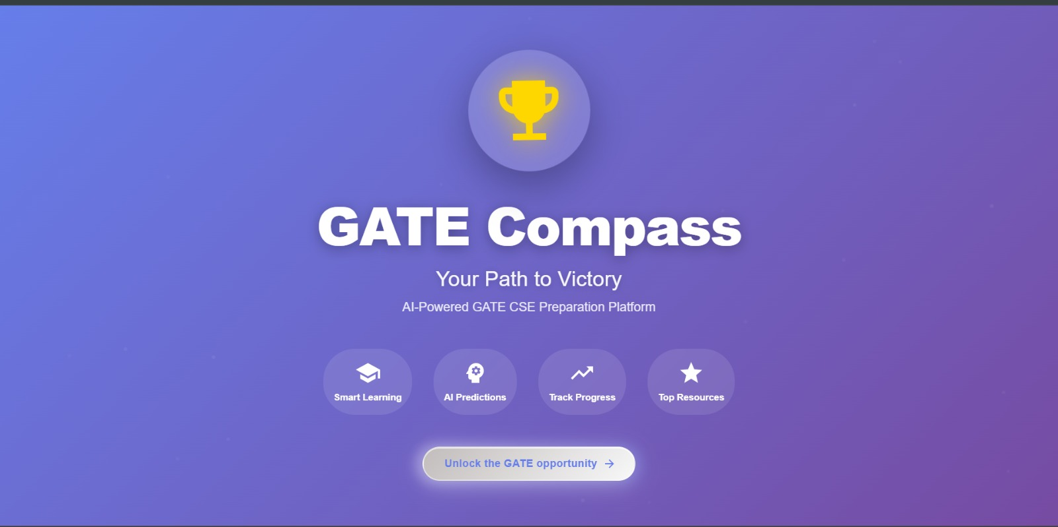
Business Model & Strategy
Revenue Model: Subscription plans (monthly/yearly).
Freemium: Basic mock test free, advanced analytics paid.
B2C Model targeting individual aspirants.
Future: Institutional licensing for colleges/training centers.

Slide 7
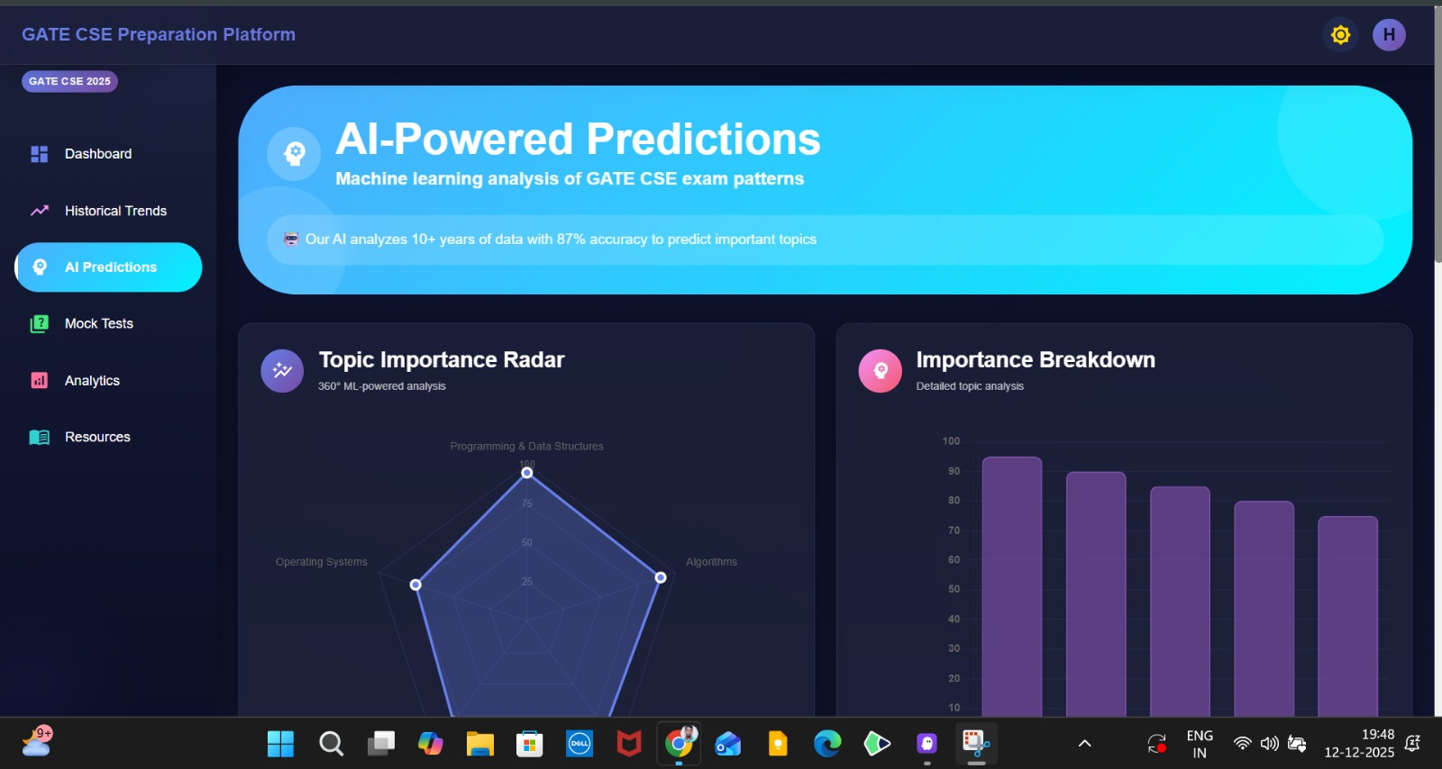
Product Milestones
MVP: Mock test generator + timer + basic analytics.
Beta: Trend analysis dashboard + admin module.
Final Launch: Full analytics, concept suggestions, user history.

Slide 8
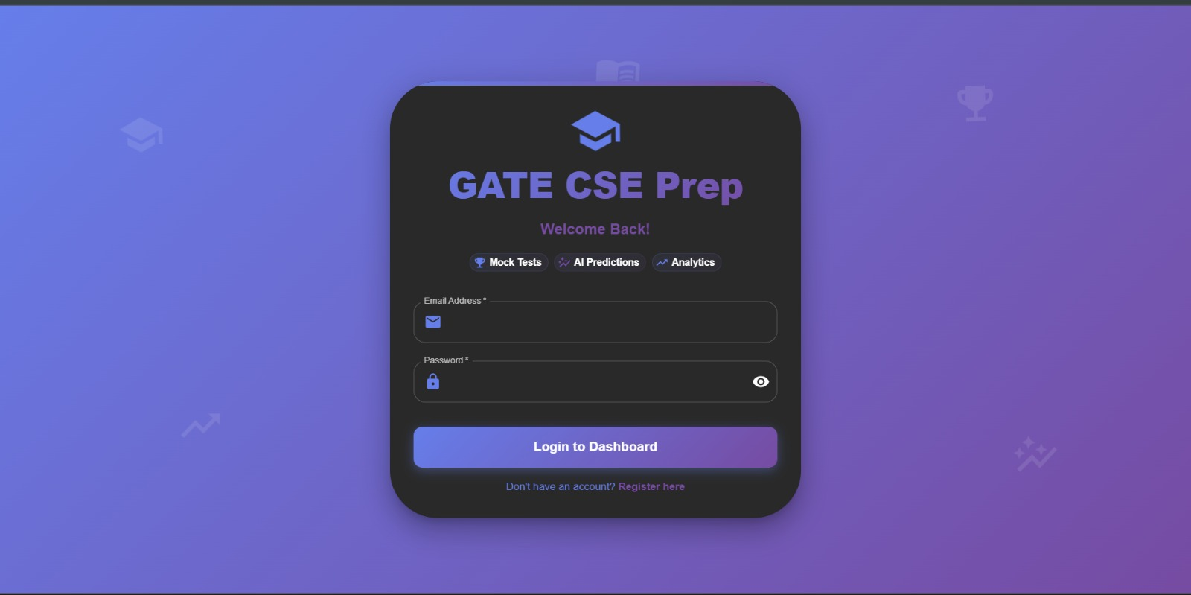
Requirement 1 – Email Login
Secure sign-in using Google OAuth.
No separate platform credentials required.
Automatic session maintenance.
Error-handling for failed authentication.

Slide 9
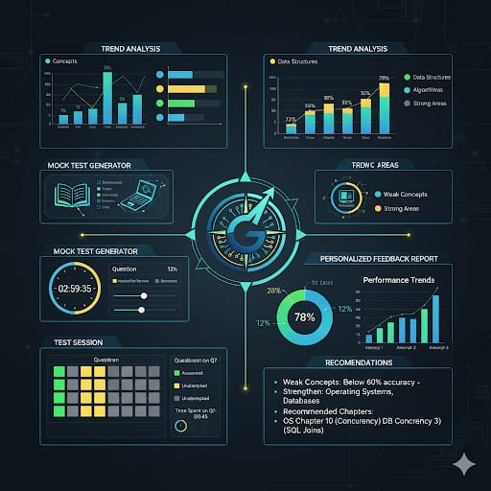
Requirement 2 – Trend Analysis
Categorizes previous year questions by concepts.
Frequency calculation & importance ranking.
Visual representation of concept trends.
Auto update when new questions are added.

Slide 10
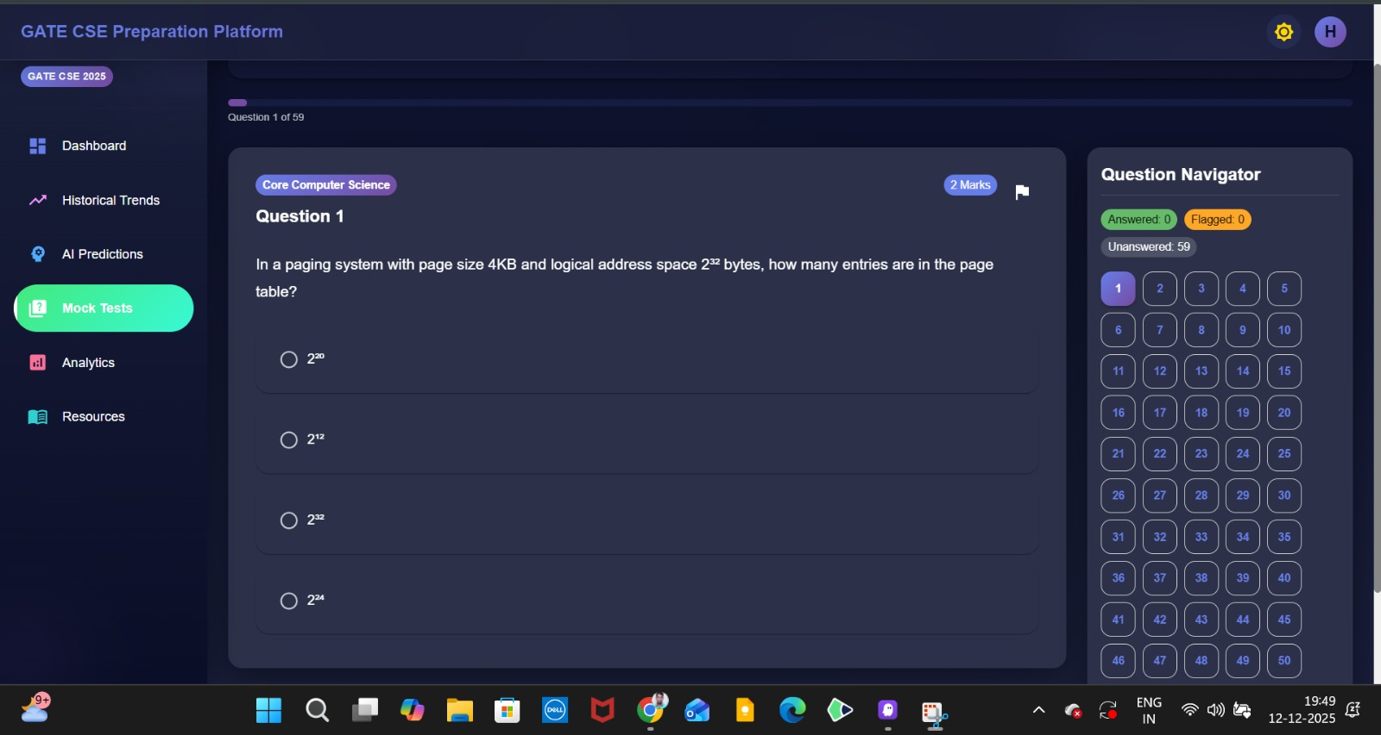
Requirement 3 – Mock Test Generation
Generates mock tests using question bank.
Prioritizes high‑importance concepts.
Ensures difficulty
balance & coverage.
Unique test session ID generated each time.

Slide 11
Requirement 4 – 3-Hour Timer
Exam-like countdown timer for mock tests.
Auto-submit on expiry.
Timer persists across navigation.
Stops on manual submission

Slide 12
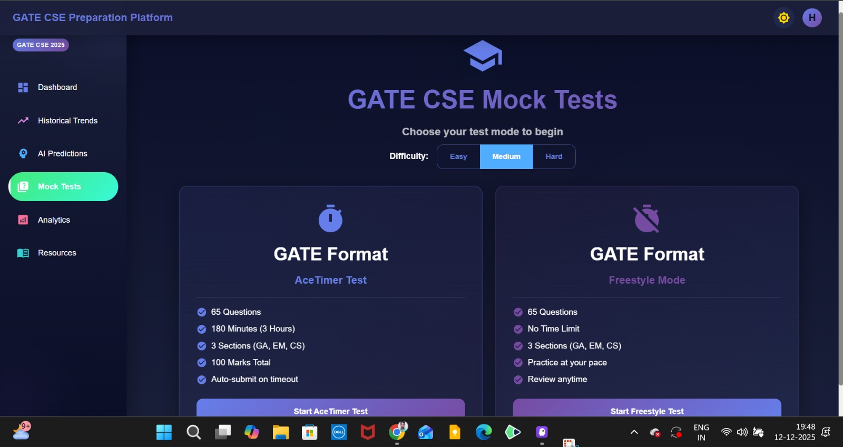
Requirement 5 & 6 – Time Tracking & Navigation
Tracks per-question time & stores results.
Question palette with answered/unanswered/review markers.
Automatic answer state saving.
Free navigation between questions

Slide 13
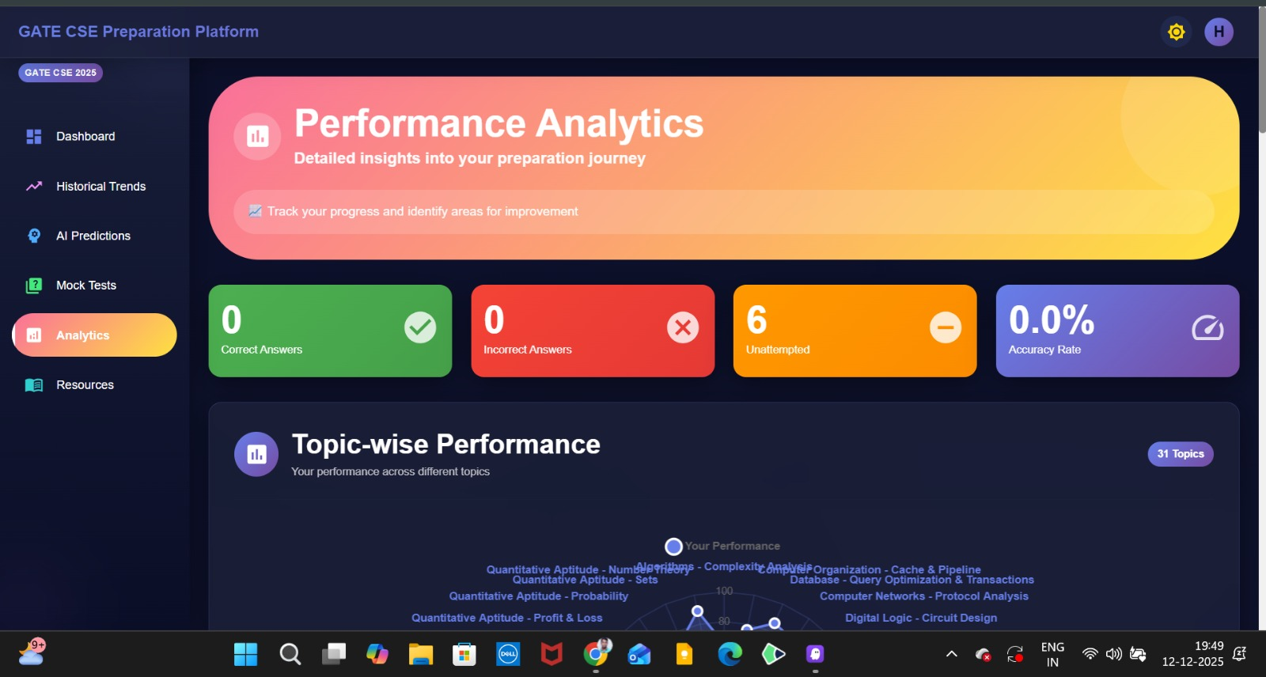
Requirement 7 & 8 – Results & Admin Controls
Score with breakdown + explanations.
Concept-wise performance analytics.
Improvement suggestions with chapter recommendations.
Admin tools to update question bank & trends.

Slide 14
Conclusion
GATE COMPASS enables smart, personalized test preparation.
Trend-based mock tests improve efficiency & accuracy.
Full analytics guide aspirants toward better performance.

